Slide 1


Slide 2

Jem Young
@jemyoung
Senior Software Engineer

Slide 3


Slide 4
Slides
jemyoung.com/fsfe

Slide 5
“Full Stack”
Command line
Shells
How the internet works
VIM
Part 1
getting started

Slide 6
What is “Full Stack?”

Slide 7


Slide 8



Frontend
Backend
magic?

Slide 9
Frontend
cars
televisions
browsers
desktop apps
appliances
mobile devices

Slide 10
Backend
APIs
data analytics
security
reliability
platform
databases

Slide 11
What is “Full Stack?”
Notes:
Story about Giza + server setup + redis

Slide 12
Someone who can build an application from start to finish
Full Stack Engineer

Slide 13
Why Full Stack?
Notes:
https://en.wikipedia.org/wiki/History_of_Python
Things don’t change as fast. Python 3 came out in 2008!
https://pythonclock.org/

Slide 14
Command Line

Slide 15
Command Line
Fast
Consistent
Easier to automate
Why the command line?
Notes:
Because graphical user interfaces are dependent on who built them

Slide 16
Command Line

Slide 17
Command Line
cd - change directory
ls - list directory contents
pwd - print working directory
mkdir - make directory
rmdir - remove directory
cat - show file contents
man - command manual
less - show file contents by page
rm - remove file
echo - repeat input
Notes:
Make a directory called fsfe
cd into directory
list the directory contents
cd back out
delete the directory

Slide 18
Shells

Slide 19

Shells

Slide 20
Shells
Command interpreter to interface with system
Shell
Runs shell applications
Terminal

Slide 21
$ echo $0
Shells
shell
application
kernel
Show current shell

Slide 22
How does the internet work?

Slide 23
How does the internet work?
A system of globally interconnected devices
Internet

Slide 24
How does the internet work?
Private internet
Intranet

Slide 25
How does the internet work?
Internet Protocol
IP
A label assigned to an internet connected device
IP Address

Slide 26
How does the internet work?
8.8.8.8
IPv4
2001:4860:4860:8888
IPv6
Notes:
IPv4 - 4.3 billion addresses 4.3 * 10⁹
IPv6 - 340 undecillion 3.4 * 10³⁸

Slide 27
How does the internet work?
Transmission Control Protocol
TCP
UDP
User Datagram Protocol
Notes:
TCP - lossless (syn, ack)
UDP - lossy - no ack

Slide 28
Ping

Slide 29
$ ping twitter.com

Slide 30
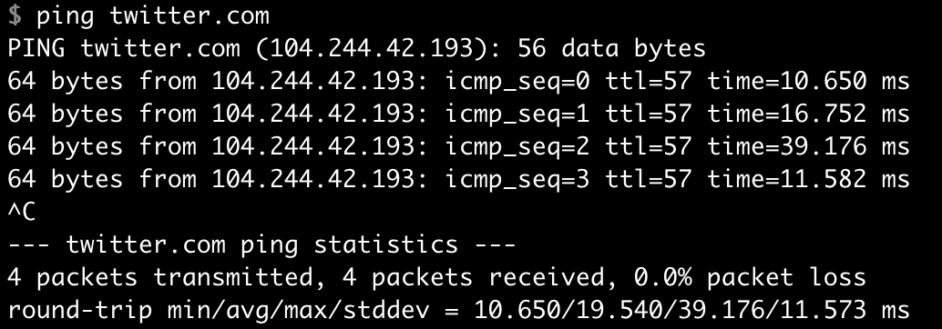

Slide 31
How does the internet work?
Domain Name System
DNS
Notes:
“The smart internet phonebook”

Slide 32

How does the internet work?
subdomain
tld
domain

Slide 33
How does the internet work?
jemyoung.com
====>
23.23.185.61

Slide 34
How does the internet work?
Map domains to IP addresses
Nameservers
Notes:
Probably won’t hit a name server though - will hit a cache

Slide 35
Trace Route

Slide 36
$ man traceroute
$ traceroute google.com
Traceroute manual
Run traceroute

Slide 37
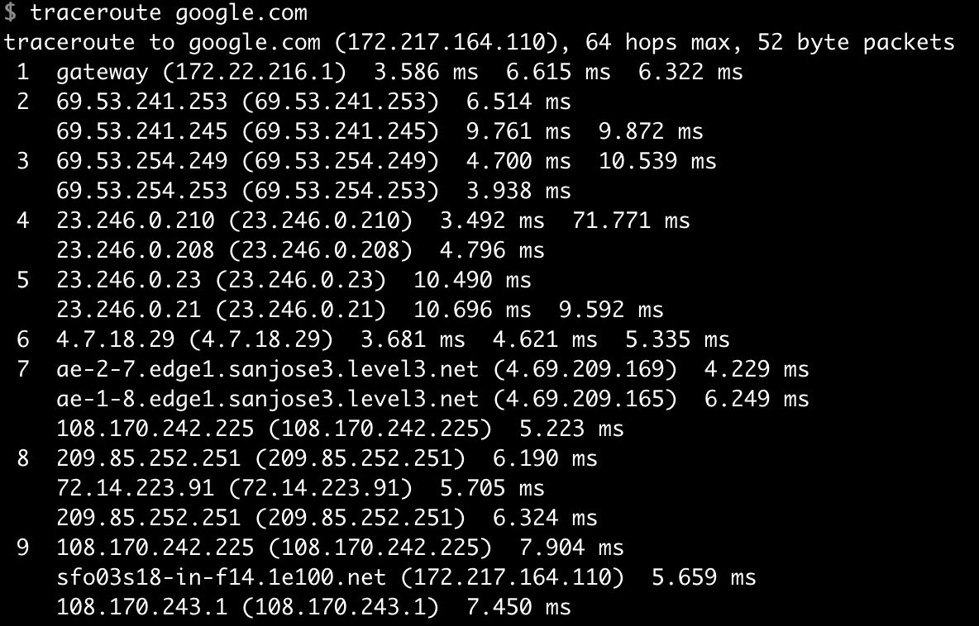

Slide 38
$ traceroute frontendmasters.com

Slide 39
How does the internet work?
ping
traceroute
Internet Control Message Protocol
ICMP

Slide 40

How does the internet work?
Packet

Slide 41
(Again) How does the internet work?

Slide 42
domain
IP
TCP
?

Slide 43
VIM

Slide 44
VIM
Vi Improved
VIM
Notes:
because servers don’t have gui’s

Slide 45
VIM
insert mode
Text editing
command mode
Primary mode
last line mode
Searching, saving, exiting
Notes:
because servers don’t have gui’s

Slide 46
VIM
insert mode
i
command mode
ESC
last line mode
:
Notes:
because servers don’t have gui’s

Slide 47
VIM
HOW TO QUIT VIM
ESC
:q!
Notes:
because servers don’t have gui’s

Slide 48
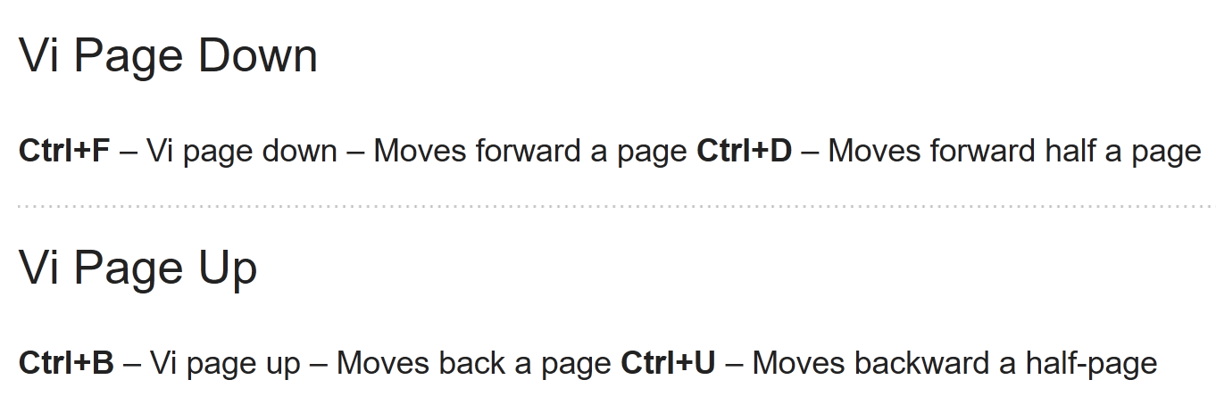
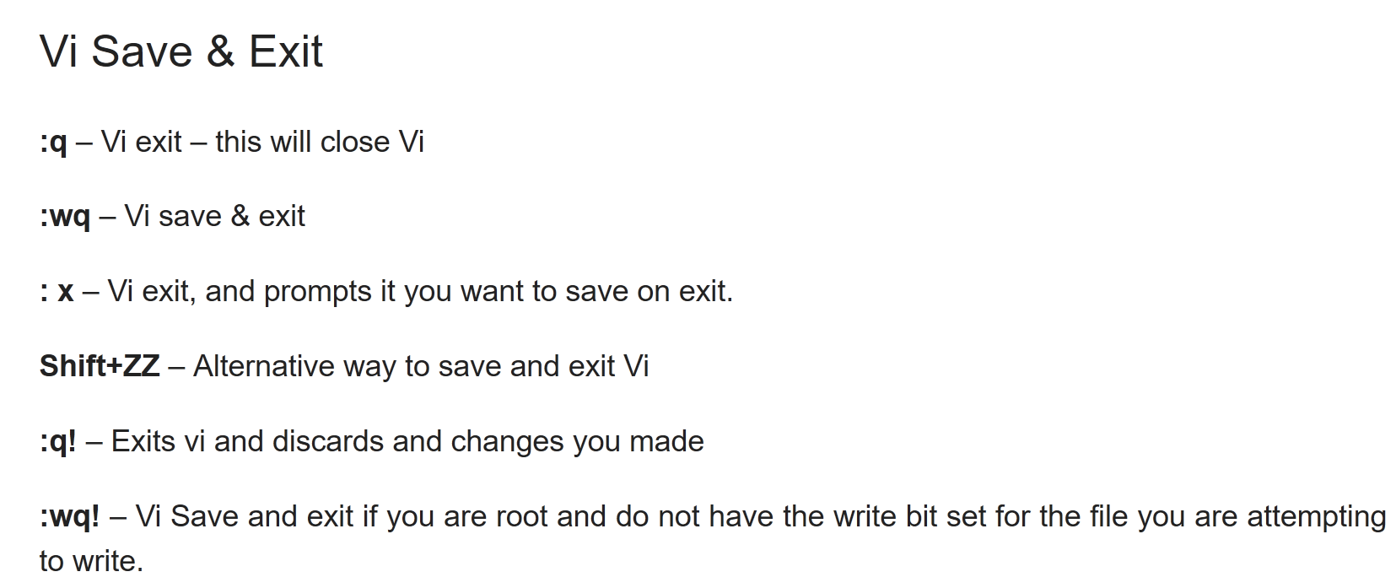
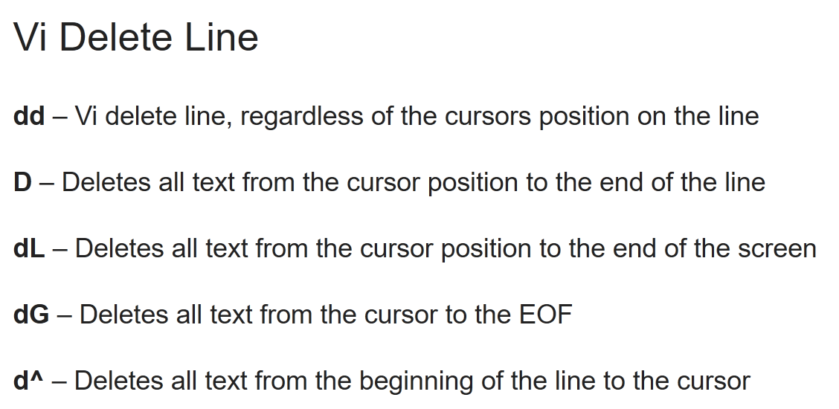
VIM
https://linuxmoz.com/vi-commands-cheat-sheet/
http://vim.wikia.com/wiki/Copy,_cut_and_paste
Notes:
because servers don’t have gui’s

Slide 49
VIM

Slide 50
$ man vi
$ vi
Notes:
https://linuxmoz.com/vi-commands-cheat-sheet/

Slide 51
Creating and editing in VIM

Slide 52
$ vi temp
Notes:
https://linuxmoz.com/vi-commands-cheat-sheet/

Slide 53
Servers
The cloud
VPS
SSH
Buying a domain
Part 2
servers ftw

Slide 54
Servers

Slide 55

Servers
What does a server do?

Slide 56

Servers
Notes:
$ python -m SimpleHTTPServer

Slide 57
Let’s make a server!

Slide 58
$ vi simpleServer.js

Slide 59
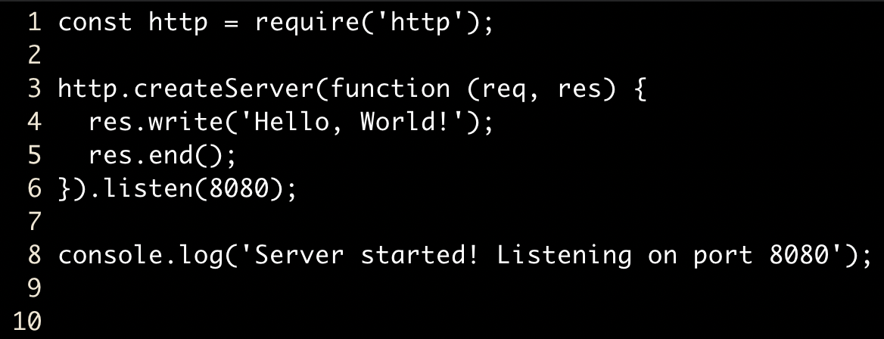
Notes:
:set number // Show line numbers
:set nonumber // Hide line numbers

Slide 60
$ node simpleServer.js
Run NodeJS script

Slide 61
Servers
Notes:
What are the characteristics of a good server?

Slide 62
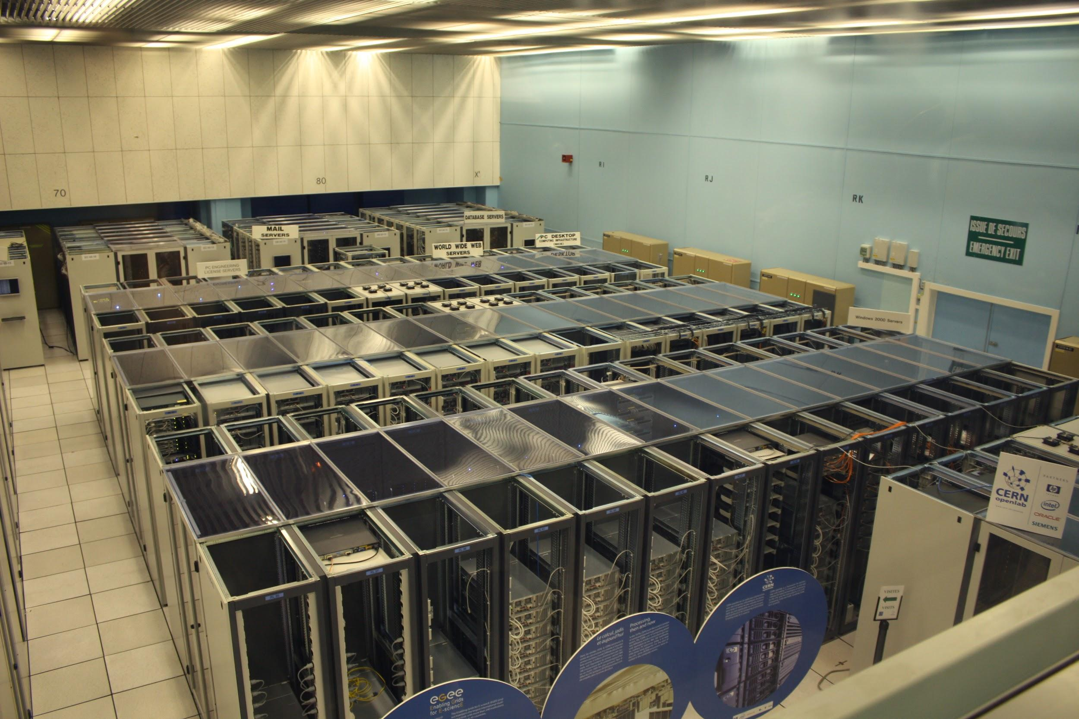
Servers
Notes:
https://commons.wikimedia.org/wiki/File:Cern_datacenter.jpg

Slide 63
Servers
Datacenter

Slide 64
The cloud

Slide 65

The cloud

Slide 66
The cloud

Slide 67
The cloud
Virtual Private Server
VPS

Slide 68
Buying a VPS

Slide 69
VPS
www.digitalocean.com

Slide 70
Operating Systems

Slide 71
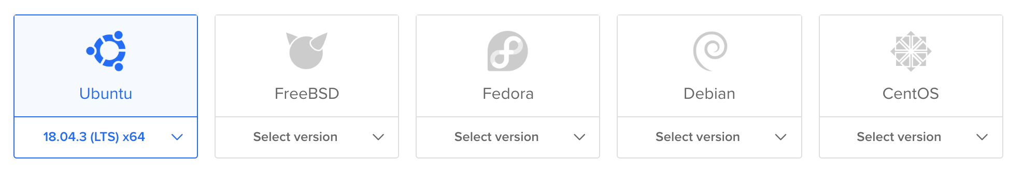
Operating Systems

Slide 72
Operating Systems
Two main types of server operating systems
windows
unix
BSD
linux*
solaris
freeBSD
ubuntu
debian
red hat
OSX/MacOS
*there are a lot more than 3
Notes:
ubiquity
open-source
(mostly) free
Unix is made up of two parts: utilities and the kernel

Slide 73
Operating Systems
Kernel
Utilities

Slide 74
Operating Systems

Slide 75
Operating Systems
Long Term Support
LTS

Slide 76
SSH

Slide 77
SSH
Authentication
username/password
ssh key
Notes:
What’s wrong with passwords?

Slide 78
SSH
Secure Socket Shell
SSH

Slide 79
SSH
public key
SSH key pair
private key

Slide 80
SSH
your computer
server
private key
encrypted messages
public key
(secret)

Slide 81
$ cd ~/.ssh
$ ls
$ ssh-keygen
Move into .ssh directory
List files
Generate ssh key

Slide 82
SSH Key

Slide 83
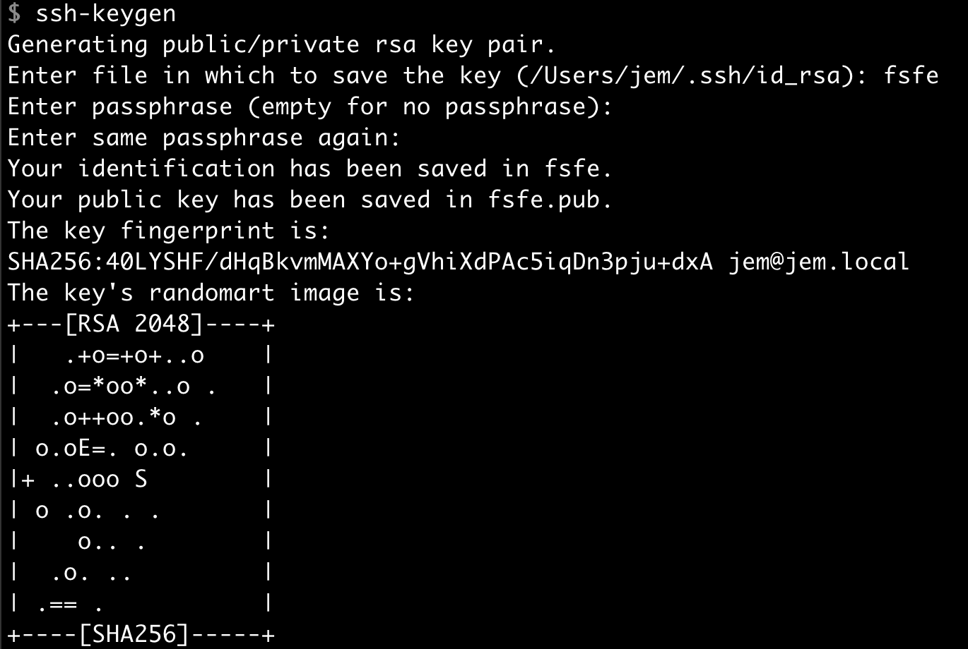

Slide 84
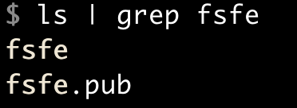
private key
public key

Slide 85
Logging in

Slide 86
$ ssh root@YOUR_IP
SSH into server
Notes:
-v for details

Slide 87
$ ssh -i ~/.ssh/fsfe root@YOUR_IP
SSH into server with key file
Notes:
-v for details

Slide 88
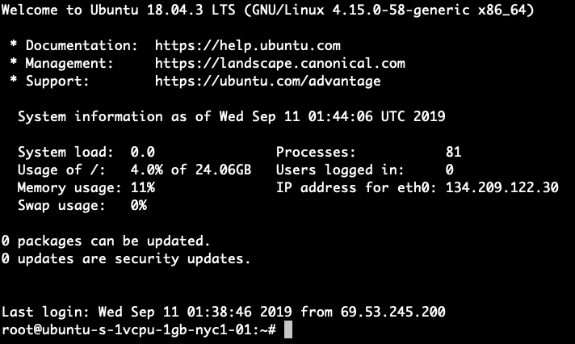
Notes:
-v for details

Slide 89

$ vi ~/.ssh/config
$ ssh-add -K ~/.ssh/fsfe
Make sure keychain is active
Add private key to keychain

Slide 90
$ ssh root@YOUR_IP
SSH into server
Notes:
-v for details

Slide 91
Buying a domain

Slide 92
Buying a domain
www.namecheap.com

Slide 93
DNS Records

Slide 94
DNS Records
Maps name to IP address
A record
Maps name to name
CNAME

Slide 95
DNS Records
www.jemyoug.com
23.23.185.61
Notes:
A record

Slide 96
DNS Records
blog.jemyoug.com
23.23.185.61
Notes:
CNAME

Slide 97
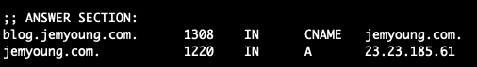
$ dig blog.jemyoung.com
DNS Records
Notes:
CNAME

Slide 98
Domain Setup

Slide 99
DNS Records
Add 2 A Records with your IP address
@
www
Use digital ocean to add domain
Update nameserver on namecheap
Notes:
masked

Slide 100
Server setup
Nginx
NodeJS
Part 3
Satisfying Server Setup

Slide 101
Server Setup

Slide 102
Server Setup
Update software
Create a new user
Make that user a super user
Enable login for new user
Disable root login

Slide 103
Server Setup
Update software
# apt update
Upgrade software
# apt upgrade
Add new user
# adduser $USERNAME
Notes:
userdel $USERNAME to delete a user

Slide 104
Server Setup
Add user to “sudo” group
# usermod -aG sudo $YOUR_USERNAME
Switch user
# su $YOUR_USERNAME
Check sudo access
$ sudo cat /var/log/auth.log

Slide 105
Server Setup
Change to home directory
$ cd ~
Create a new directory if it doesn’t exist
$ mkdir -p ~/.ssh
Create authorized_keys file and paste PUBLIC key
$ vi ~/.ssh/authorized_keys

Slide 106
Server Setup
Exit
$ exit
# exit
Login with new user
$ ssh $USERNAME@IP_ADDRESS
Notes:
sudo -i to switch to root

Slide 107
Server Setup
Change file permissions
$ chmod 644 ~/.ssh/authorized_keys
Disable root login
$ sudo vi /etc/ssh/sshd_config
Notes:
http://www.filepermissions.com/file-permission/644

Slide 108
Server Setup
Restart ssh daemon
$ sudo service sshd restart
Notes:
sudo -i to switch to root

Slide 109
Nginx

Slide 110
Nginx
Reverse proxy
Web server
Proxy server
Nginx
(engine-x)

Slide 111
Nginx
App
request
Database

Slide 112
Nginx
App
request
Nginx
Database

Slide 113
Nginx

Slide 114
$ sudo apt install nginx
$ sudo service nginx start
Install nginx
Start nginx

Slide 115
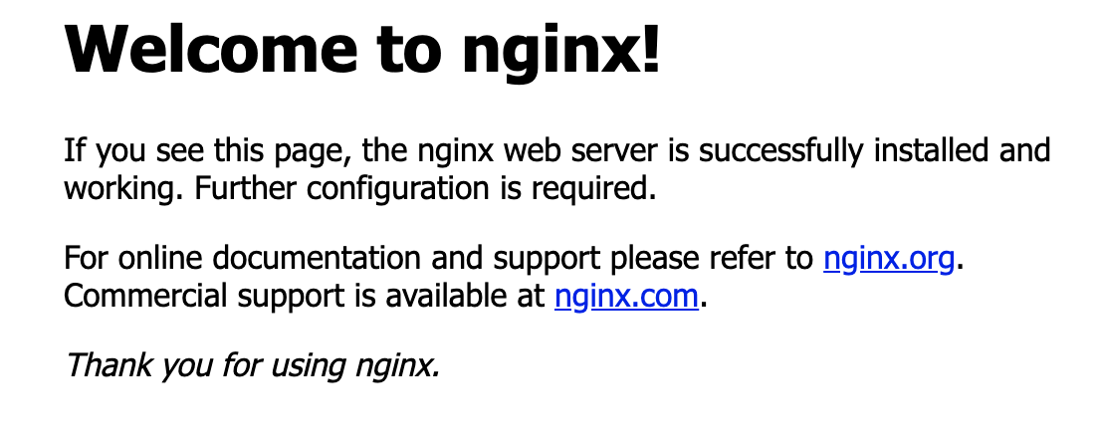

Slide 116

Nginx
?
domain
IP
Nginx

Slide 117
Nginx
Show nginx configuration
$ sudo less /etc/nginx/sites-available/default

Slide 118
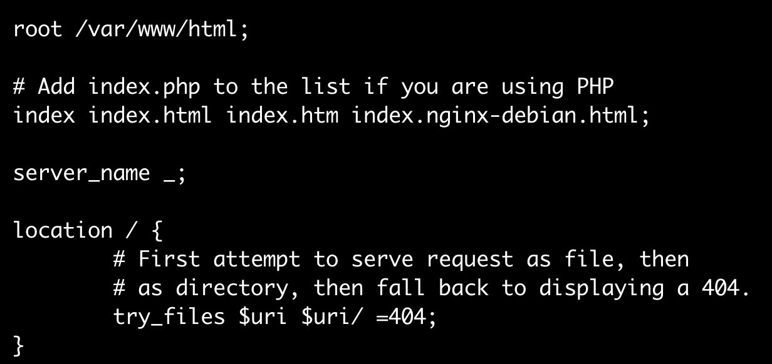
Nginx
base directory for requests
Notes:
https://www.nginx.com/resources/wiki/start/topics/tutorials/config_pitfalls/

Slide 119
Nginx
location block
Notes:
https://www.nginx.com/resources/wiki/start/topics/tutorials/config_pitfalls/

Slide 120
Nginx
directive
Notes:
http://nginx.org/en/docs/dirindex.html

Slide 121
Nginx
html defaults
Notes:
https://www.nginx.com/resources/wiki/start/topics/tutorials/config_pitfalls/

Slide 122
Default page

Slide 123
$ sudo vi /var/www/html/index.html
Create and edit index.html

Slide 124
NodeJS

Slide 125

NodeJS

Slide 126
$ sudo apt install nodejs npm
$ sudo apt install git
NodeJS
Install NodeJS and npm
Install git

Slide 127
Application Server
Process Manager
Git
Part 4
Master of the stack

Slide 128
Application Architecture

Slide 129
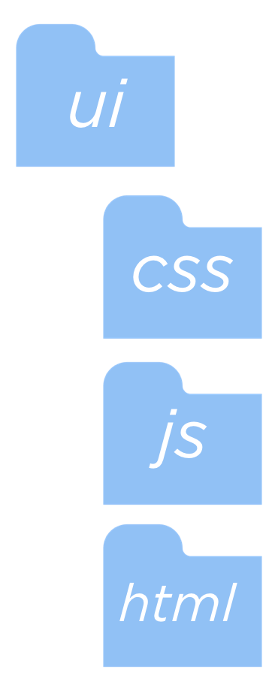
Application Architecture

Slide 130
Application Setup

Slide 131
$ sudo chown -R $USER:$USER /var/www
$ mkdir /var/www/app
$ cd /var/www/app && git init
Change ownership of the www directory to the current user
Create application directory
Move into app directory and initialize empty git repo

Slide 132
$ mkdir -p ui/js ui/html ui/css
$ touch app.js
$ npm init
Create directories
Create empty app file
Initialize project

Slide 133
$ npm i express --save
$ vi app.js
install express
edit app

Slide 134
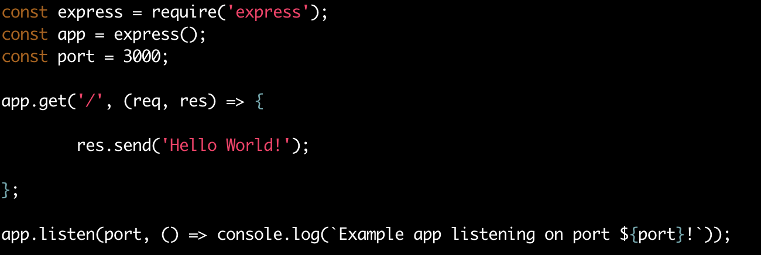
https://www.dropbox.com/s/8wlwz5wdp7ohe16/Screenshot%202019-09-18%2022.34.07.png?dl=0
)
https://expressjs.com/en/starter/hello-world.html

Slide 135
$ node app.js
Run application

Slide 136
Nginx
?
domain
IP
Nginx
Express

Slide 137
Nginx
location / {
proxy_pass URL_TO_PROXY_TO;
}

Slide 138
Proxy pass

Slide 139
$ sudo vi /etc/nginx/sites-available/default
Edit nginx config
location / {
proxy_pass http://127.0.0.1:3000/;
}

Slide 140
What about server restarts?
Notes:
200 - ok
201 - created

Slide 141
Process Manager

Slide 142
Process Manager
Keeps your application running
Handles errors and restarts
Can handle logging and clustering

Slide 143
Process Manager

Slide 144
$ sudo npm i -g pm2
$ pm2 start app.js
$ pm2 save
$ pm2 startup
Install PM2
Start PM2
Setup auto restart

Slide 145
Version Control

Slide 146
Version Control
Record changes to a file system to preserve the history.
Version Control
Git
Subversion
Mercurial

Slide 147
Static Files

Slide 148
Static Files
app.use(express.static(‘ui’))

Slide 149
Git

Slide 150
Create git repository
Create SSH key
Add SSH key to Github
Add remote repo
Push local repository to Github*
*Don’t forget to add a .gitignore file so you don’t commit node_modules/

Slide 151
Congratulations!

Slide 152
Further Exploration
Install Fail2ban
https://www.techrepublic.com/article/how-to-install-fail2ban-on-ubuntu-server-18-04/
ExpressJS performance tips
http://expressjs.com/en/advanced/best-practice-performance.html

Slide 153
Recap
Frontend
Backend
magic?

Slide 154
Recap
domain
IP
Server
Web server
Application server

Slide 155
Recap
Command line basics
How the internet works
How to create and manage a web server
Create a Node application

Slide 156
Standard streams
Redirection
Finding things
Nginx
Part 1
bit of this, bit of that

Slide 157
Standard Streams

Slide 158
Standard Streams
standard output
stdout
standard input
stdin
standard error
stderr
Notes:
POSIX standard - portable operating system interface

Slide 159
Redirection

Slide 160
Redirection
|
read from stdout
>
write stdout to file
>>
append stdout to file
<
read from stdin
2>
read from stderr

Slide 161
Redirection
What does this do?
foo > bar

Slide 162
Finding Things

Slide 163
Finding things
search file names
find
search file contents
grep

Slide 164
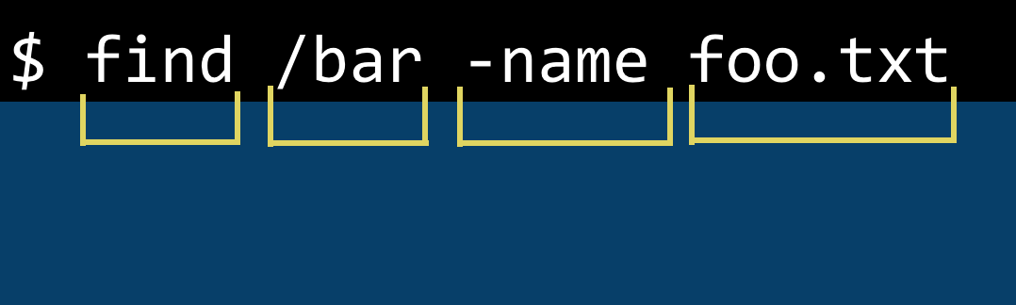
Finding things
find
find
directory
option
file/folder

Slide 165
Finding things
useful options
find
-name
-type
-empty
-executable
-writable

Slide 166
Find

Slide 167
$ find /var/log/nginx -type f -name “*.log”
Find all log files in /var/log

Slide 168
$ find / -type d -name log
Find all directories with the name ‘log’

Slide 169
Finding things
$ grep -i ‘jem’ /var/www
grep
options
search
expression
directory
grep
$ zgrep FILE
search inside gzip file

Slide 170
Grep

Slide 171
$ ps aux | grep node
Find running node processes
Notes:
a = show processes for all users
u = display the process's user/owner
x = also show processes not attached to a terminal

Slide 172
Nginx

Slide 173
Nginx - Redirect
location /help {
return 301 https://developer.mozilla.org/en-US/;
}

Slide 174
Nginx - Subdomain
server {
listen 80;
listen [::]80; # IPV6 notation
server_name test.jemisthe.best;
location / {
proxy_pass http://localhost:3000;
}
}
Notes:
Virtual host

Slide 175
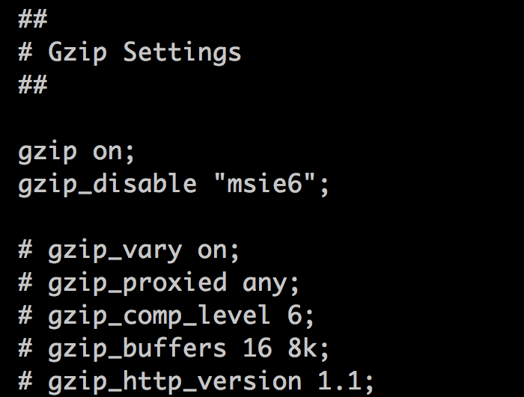
Nginx - Gzip
/etc/nginx/nginx.conf
Notes:
Virtual host

Slide 176
Controlling access
Securing applications
Firewalls
Permissions
Upgrade NodeJS
Part 2
Security

Slide 177
Security

Slide 178
$ sudo cat /var/log/auth.log
Read auth.log
Notes:
https://www.maxmind.com/en/geoip-demo

Slide 179
Security
What could someone do if they gained root access to your server?

Slide 180
Security
SSH
Firewalls
Updates
Two factor authentication
VPN

Slide 181
Updates

Slide 182
$ sudo apt install unattended-upgrades
$ cat /etc/apt/apt.conf.d/50unattended-upgrades
Application Updates
Install unattended upgrades
View conf file
Notes:
https://wiki.debian.org/UnattendedUpgrades

Slide 183
Firewalls

Slide 184
Firewall
“A network security device that monitors incoming and outgoing network traffic and decides whether to allow or block specific traffic based on a defined set of security rules.”
Firewall
https://www.cisco.com/c/en/us/products/security/firewalls/what-is-a-firewall.html

Slide 185

Firewall

Slide 186
nmap

Slide 187
$ sudo apt install nmap
$ man nmap
$ nmap YOUR_SERVER_IP_ADDRESS
$ nmap -sV YOUR_SERVER_IP_ADDRESS
Install nmap
Run nmap
Run nmap with more service/version info
Notes:
nmap -h | grep sV

Slide 188
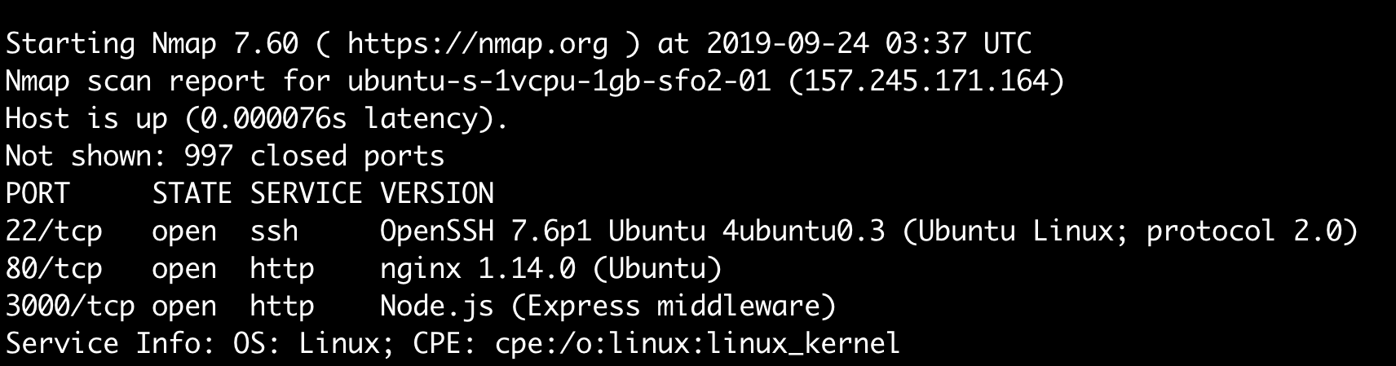

Slide 189
Firewall
communication endpoint that maps to a specific process or network service
port

Slide 190
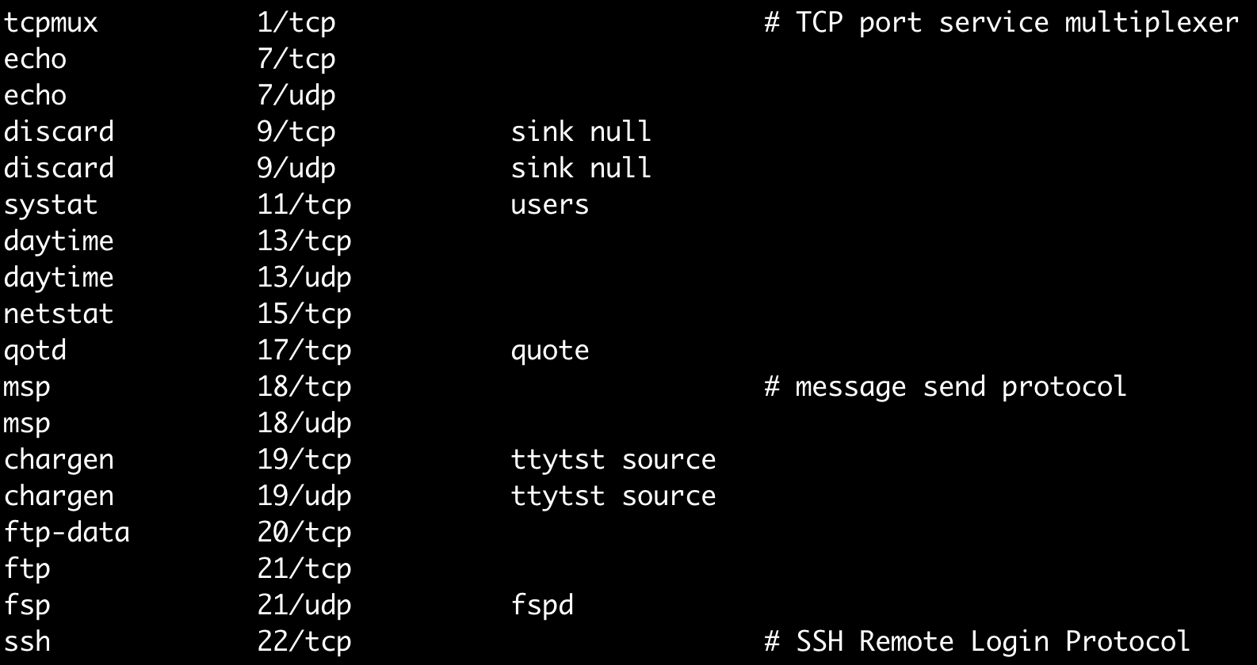
$ less /etc/services
Firewall

Slide 191
iptables -p tcp --dport 80 -j REJECT
Firewall
Notes:
IPtables - administration for packet filtering
Reject all http requests

Slide 192
Firewall
uncomplicated firewall
ufw

Slide 193
$ ufw allow ssh
Firewall
http
https
deny
reject
Notes:
Reject - send error packet of connection refused
Deny - silently drop connection - useful in case of DDOS

Slide 194
ufw

Slide 195
$ sudo ufw status
$ sudo ufw allow ssh
$ sudo ufw enable
Check firewall status
Enable ssh
Enable firewall

Slide 196
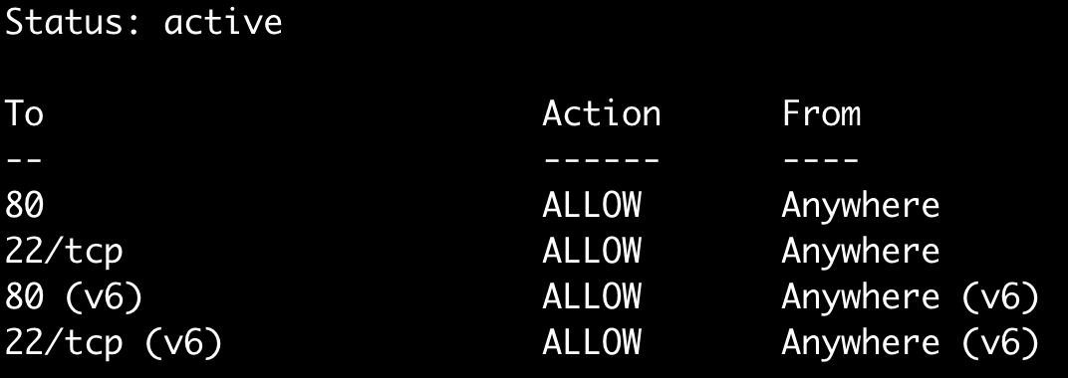

Slide 197
How would you create a ufw rule to block all HTTP connections?

Slide 198
sudo ufw reject http
Notes:
sudo ufw allow http
sudo ufw delete deny 80/tcp

Slide 199
Permissions

Slide 200
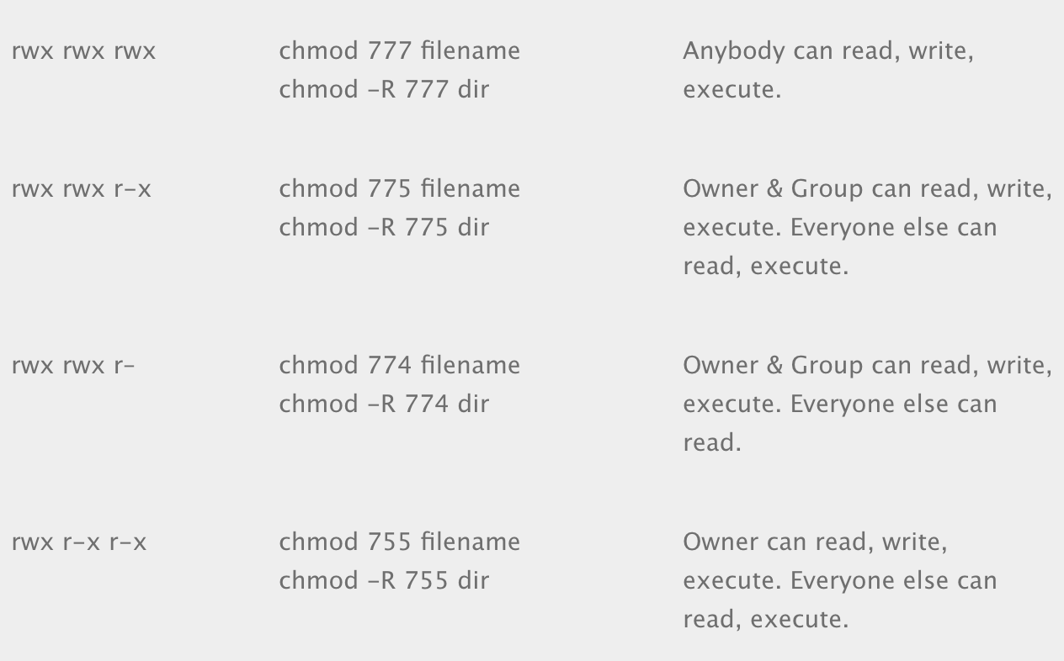
Permissions
https://isabelcastillo.com/linux-chmod-permissions-cheat-sheet

Slide 201
Upgrade node

Slide 202
$ curl -sL https://deb.nodesource.com/setup_10.x -o nodesource_setup.sh
$ sudo bash nodesource_setup.sh
$ sudo apt install nodejs
Download setup script from nodesource
Run script
Install nodejs
Notes:
https://explainshell.com/explain?cmd=curl+-sL
https://www.digitalocean.com/community/tutorials/how-to-install-node-js-on-ubuntu-18-04

Slide 203
$ sudo npm update -g
Application Updates
Update outdated packages

Slide 204
HTTP
Headers
Status codes
HTTPS
Certbot
HTTP/2
HTTP/3
Part 3
HTTP/*

Slide 205
HTTP

Slide 206
HTTP
hypertext transport protocol
HTTP

Slide 207
HTTP
HTTP
request
response

Slide 208
HTTP
GET / HTTP/1.1
Host: jemisthe.best
User-Agent: Mozilla/5.0 (Macintosh; Intel Mac OS X 10_14_5) AppleWebKit/537.36 (KHTML, like Gecko) Chrome/76.0.3809.132 Safari/537.36
Accept: text/html
Accept-Encoding: gzip, br
Accept-Language: en,en-US
request

Slide 209
HTTP Headers

Slide 210
HTTP
GET / HTTP/1.1
Host: jemisthe.best
User-Agent: Mozilla/5.0 (Macintosh; Intel Mac OS X 10_14_5) AppleWebKit/537.36 (KHTML, like Gecko) Chrome/76.0.3809.132 Safari/537.36
Accept: text/html
Accept-Encoding: gzip, br
Accept-Language: en,en-US
request

Slide 211
HTTP
common headers
User-agent | The requesting device type
Accept | What the device will handle
Accept-language | Browser languages
Content-type | The type of media
Set-cookie | Sets stateful information
X- | Typically used for custom headers

Slide 212
HTTP
HTTP/1.1 200 OK
Server: nginx/1.14.0 (Ubuntu)
Date: Wed, 25 Sep 2019 02:13:13 GMT
Content-Type: text/html; charset=utf-8
Content-Length: 12
response

Slide 213
Status Codes

Slide 214
Status Codes
Indicates the status of an HTTP request
HTTP Status Code

Slide 215
Status Codes
200 | OK
301 | Moved permanently
302 | Found (temporary redirect)
401 | Not authorized
500 | Internal server error

Slide 216
Status Codes
1xx | Information
2xx | Success
3xx | Redirect
4xx | Client error
5xx | Server error

Slide 217
What is the proper status code for a successful POST request?
Notes:
200 - ok
201 - created

Slide 218
Headers and Status Codes

Slide 219
In your app, create a path that returns 418 and a custom header.
hint: res.status(), res.set()

Slide 220
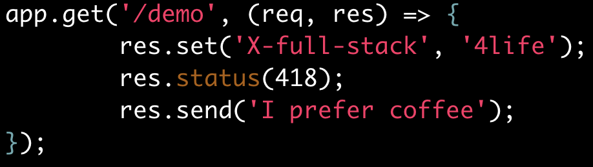

Slide 221
HTTPS

Slide 222
HTTPS
frontendmasters.com
Visa 4235529596901600

Slide 223
HTTPS
frontendmasters.com
Evil Server
Visa 4235529596901600

Slide 224
HTTPS
https://frontendmasters.com
*Ifkfi24fh243&&o9#$kD#!8b
Notes:
Service Workers
Web Bluetooth
HTTP/2

Slide 225

HTTPS
Notes:
EFF + Let’s Encrypt = Certbot

Slide 226
Certbot

Slide 227
https://certbot.eff.org/

Slide 228


Slide 229
HTTP/2

Slide 230

HTTP/2
http/1.1
TCP
TCP
TCP
Notes:
https://w3techs.com/technologies/details/ce-http2/all/all

Slide 231
HTTP/2
http/2
TCP
Notes:
Multiplexing
Header compression with HPACK
Server push

Slide 232
http/2

Slide 233
$ sudo vi /etc/nginx/sites-available/default
Edit nginx config
listen 443 http2 ssl;

Slide 234
HTTP/3

Slide 235
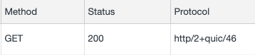
HTTP/3
Quick UDP Internet Connections
QUIC
Notes:
QUIC -> UDP
https://kinsta.com/blog/http3/

Slide 236
Microservices
Containers
Orchestration
Load balancers
Deployments
Part 4
Containers

Slide 237
Microservices

Slide 238
Microservices
Architecture of loosely connected services
Microservices

Slide 239
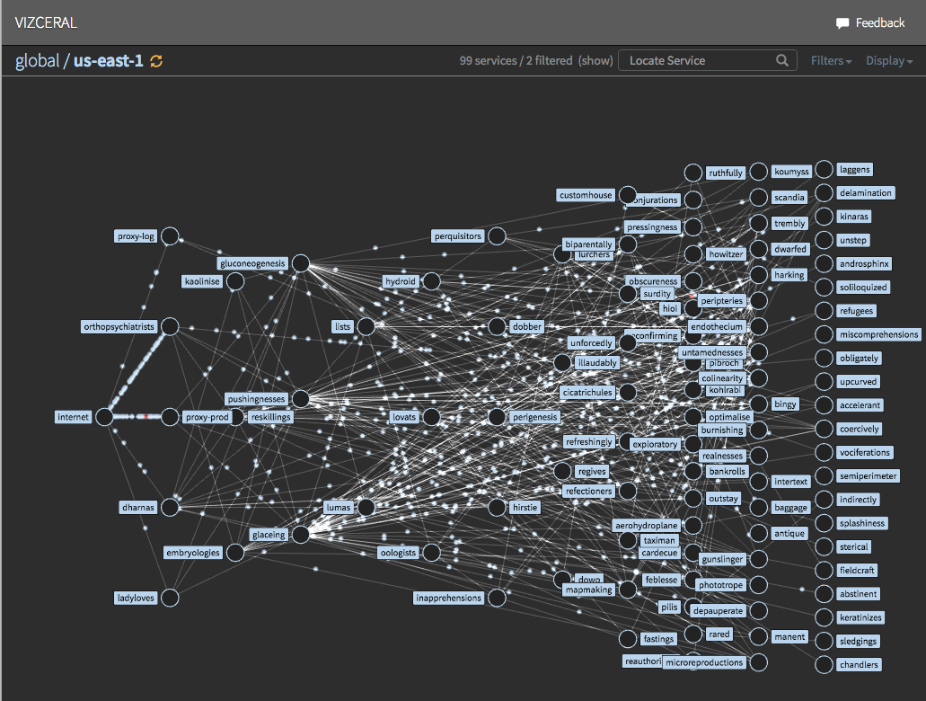
Microservices

Slide 240
Containers

Slide 241
The cloud

Slide 242
Containers
VPS

Slide 243
Containers
Ubuntu
NodeJS
MySQL
Nginx
Python

Slide 244
Containers
Ubuntu
NodeJS
MySQL
Nginx
Python

Slide 245
Containers
OSX
Fedora
NodeJS
MySQL
NodeJS
MySQL
Nginx
Python
Nginx
Python

Slide 246
Containers
Lightweight
Portable
Easier for development
Easier to manage
Faster startup
Decouple application from infrastructure

Slide 247

Containers
Amazon ECS
Apache Mesos
CoreOS rkt

Slide 248
Orchestration

Slide 249
Orchestration

Slide 250

Orchestration
Docker Swarm
Amazon EKS
Apache Mesos
AKS
Kubernetes
“K8s”

Slide 251
Load Balancers

Slide 252
Load Balancers
90%
request
?
15%

Slide 253
Load Balancers
90%
request
Load Balancer
15%

Slide 254
Load Balancers
Round Robin*
IP Hashing
Random Choice
Least Connections
Least Load
Scheduling Algorithms
Notes:
* default
What about session persistence?

Slide 255
top

Slide 256
$ top
$ sudo apt install htop
$ htop
Display running processes
Install htop
Display running processes

Slide 257
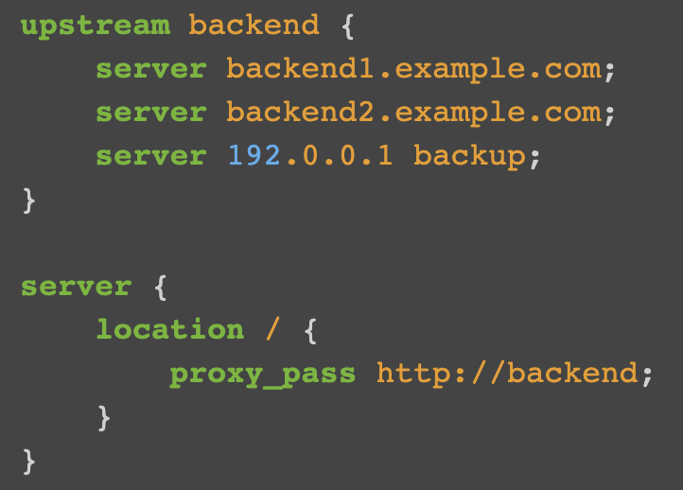
Load Balancers

Slide 258
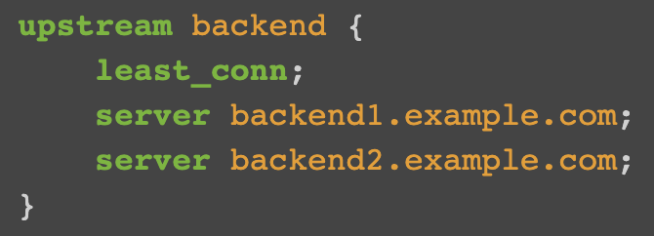
Load Balancers
https://docs.nginx.com/nginx/admin-guide/load-balancer/http-load-balancer/

Slide 259
Deployments

Slide 260



Deployments

Slide 261
Files
Databases
Part 5
Saving Data

Slide 262
Files

Slide 263

Files
Why not save everything to a file?

Slide 264
Databases

Slide 265



Databases
relational
SQL
Tables
Related data
Strict structure

Slide 266




Databases
non-relational
NoSQL
Data agnostic
Loose structure
Notes:
Redis - key/value store
Mongo - document store
Elastic search - good searching and indexing

Slide 267
Redis

Slide 268
$ sudo apt install redis-server
$ sudo vi /etc/redis/redis.conf
$ sudo systemctl restart redis.service
Redis
Install redis server
Edit config to start with system
Restart redis server

Slide 269
Redis
https://github.com/NodeRedis/node_redis

Slide 270
MySQL

Slide 271
MySQL
Install mysql server
$ sudo apt install mysql-server
Run setup
$ mysql_secure_installation

Slide 272
MySQL
https://github.com/mysqljs/mysql

Slide 273
Websockets
Part 6
Final Project

Slide 274
Websockets

Slide 275
Websockets
Persistent bidirectional connection between client and server
Websocket

Slide 276
Websockets
location / {
proxy_set_header Upgrade $http_upgrade;
proxy_set_header Connection "upgrade";
proxy_pass http://127.0.0.1:3000;
}

Slide 277
Final Project

Slide 278
Final Project
https://github.com/young/fsfev2
Create a chat bot using websockets
Notes:
$ hello -> hello
PING -> PONG
Bonus: deploy app to a subdomain
HELP

Slide 279
Congratulations!

